Slide 1
Trusted Routing in IoT
Dr Ivana Tomić In collaboration with:
Research Associate Prof. Julie A. McCann and
Imperial College London AESE group
Email: i.tomic@imperial.ac.uk

Slide 2
Outline
Sensors and Sensor Networks – Are these the most Critical
Components in IoT?
What is the Security & Cyber Risk in IoT?
How big is the Loss of Data due to the Break in Routing Paths?
How to establish a Trusted Routing in IoT?

Slide 3
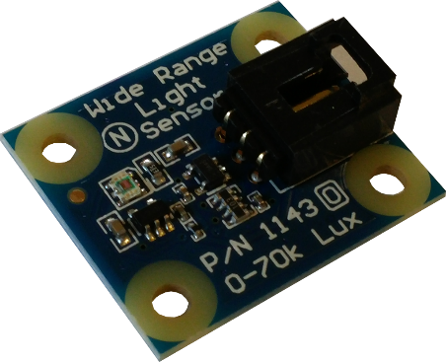
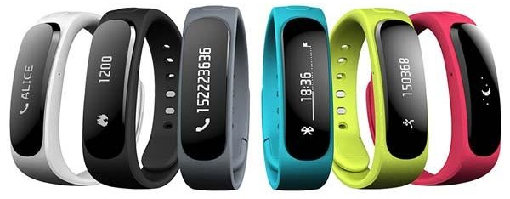
Sensors and networks: A value-creation framework
A heavy reliance on wireless communications (typically a best-effort network).
A range of communication protocols to satisfy the communication needs of diverse applications.
Wireless Sensor Network
many low-cost, low-power devices communicating wirelessly with BS
Sources of information

Slide 4
IoT systems differ from traditional IT systems?
Environment: physical exposure of IoT devices
Resources: sensors are low-cost, low-power, resource constrained devices
Variety: more types of devices and different types of networks in IoT
Volume: billions of IoT devices compared to millions of IT devices
Consequences: disruption of IoT systems could lead to large economic losses and have a significant impact on the welfare of people
BUT it also creates new opportunities for all that information to be compromised!

Slide 5
The communication protocols have not been designed with a security goal in mind
Denial of service,
Man in the middle
Attacks on reliability,
Malicious code attack
Multi-Layer
Application Layer
Transport Layer
Network Layer
Data Link Layer
Physical Layer
Data integrity attack,
Energy drain attack,
Desyncronisation attack
Spoofing/replaying information,
Selective forwarding/black holes,
Sinkhole attack,
Sybil attack,
Node replication attacks,
Wormhole attack,
Hello flood attack
WSN Layered
Architecture
Jamming,
Collision
Jamming,
Node tampering, Eavesdropping
External vs. Internal Attacks

Slide 6
The network level attacks can cause data loss and increase the data collection latency
Network communication can be attacked, causing the loss of data which can compromise system functionality and cause failure.
?
SENSITIVE DATA!
TIME-CRITICAL DATA!
1
1
1
2
3
3
3
2
2
4
6
4
6
4
6
7
7
“I am the root!”
7
8
9
9
8
9
8
Blackhole attack
Sinkhole attack
Replay attack

Slide 7
Understanding the impact and consequences of an attack helps to prevent possible DoS
Implementation: Contiki OS & Cooja (Contiki simulator), 100nodes random topology
Observations:
Each attack has it’s own signature wrt to the network performance.
Two groups: 1. attacks that introduce additional data → reduced PDR and increased E2E delay 2. attacks that reduce no. of packets → reduced PDR and reduced E2E delay.

Slide 8
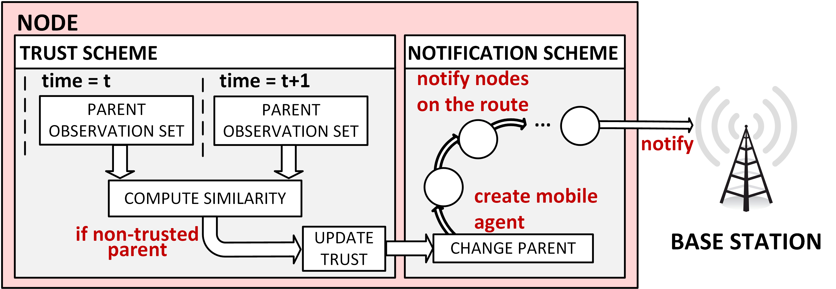
A novel self-healing scheme that detects and recovers from common attack scenarios

Slide 9
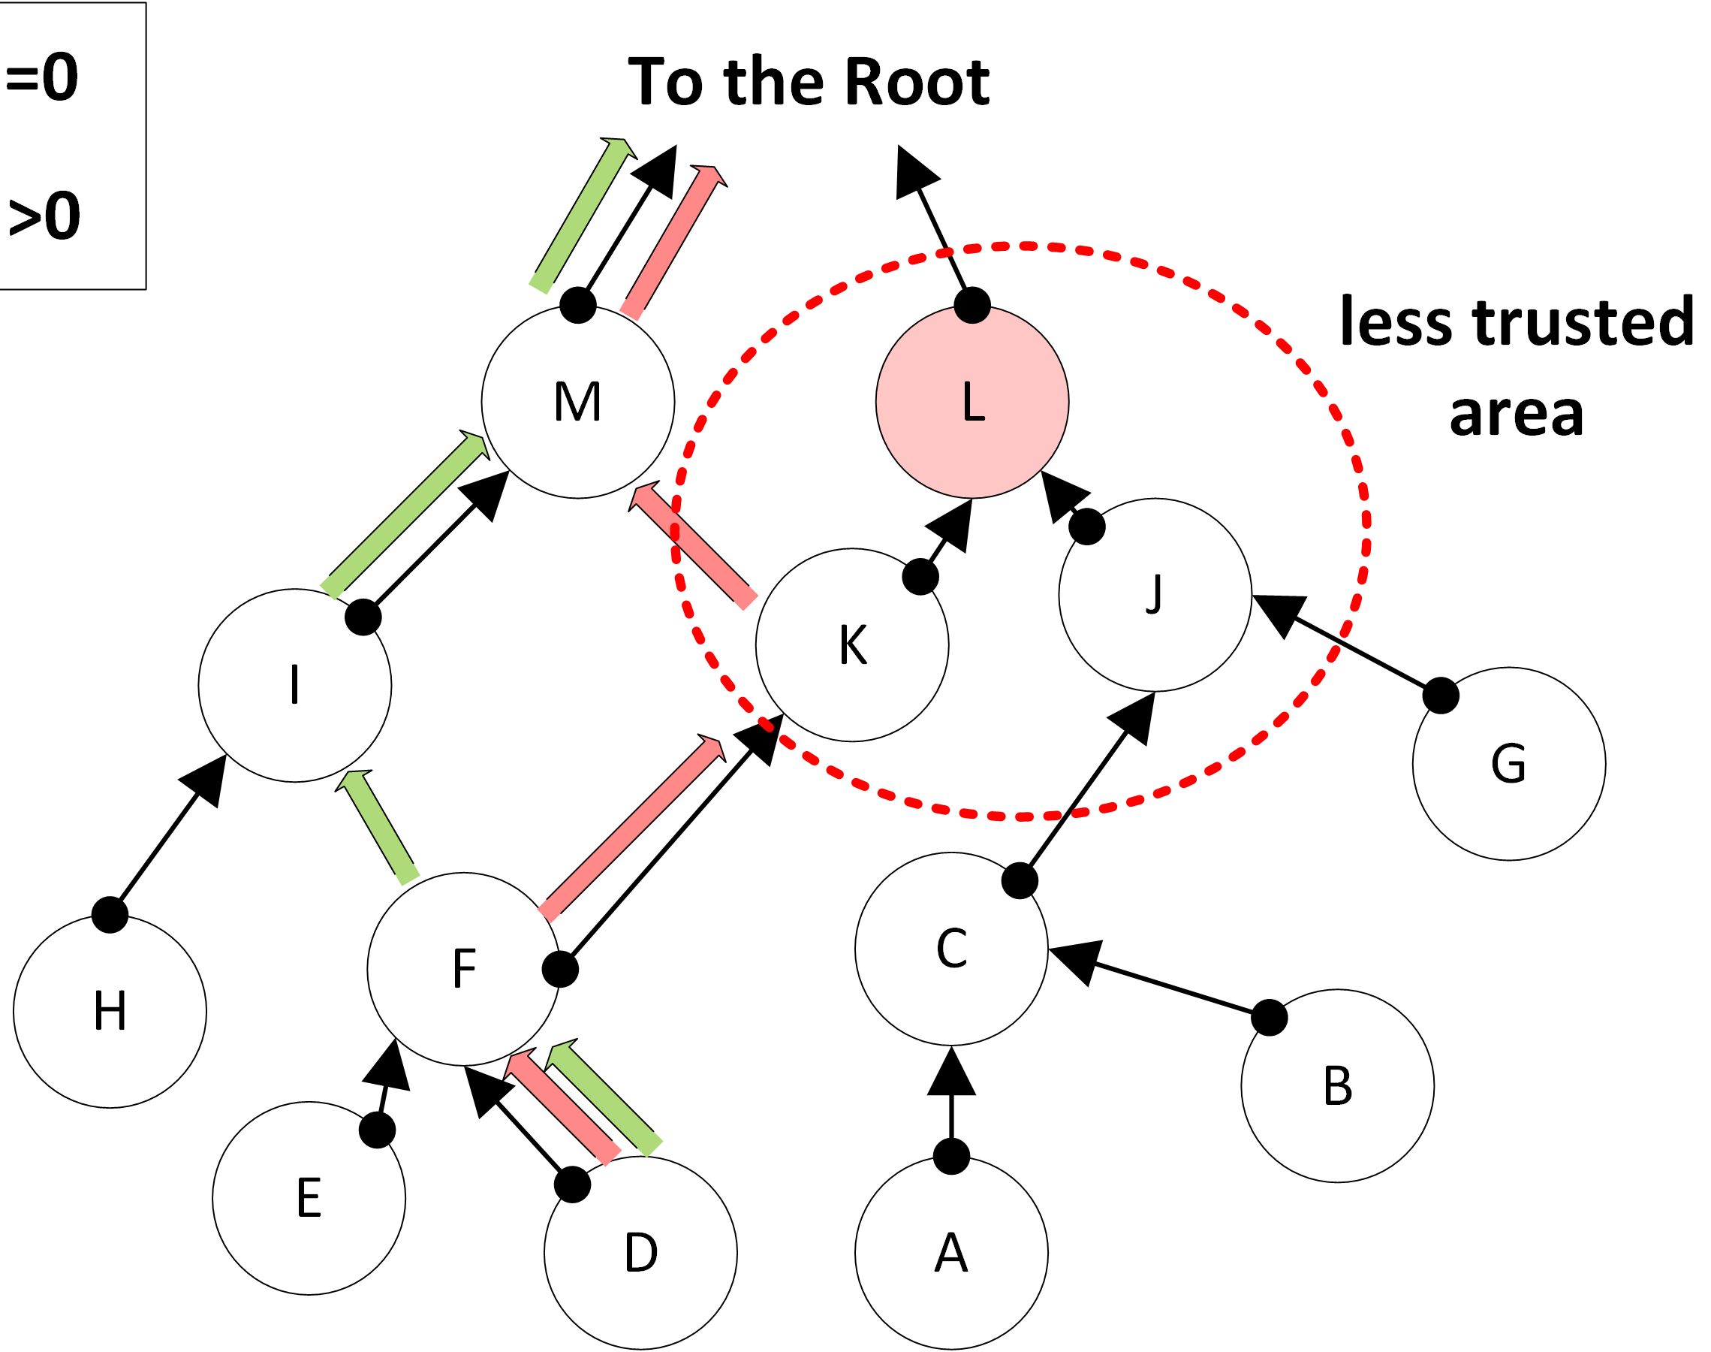
Each sensor builds a trust model of its neighbourhood to adapt routing decisions
Pairwise trust between a node and its neighbours.
Choose your routing paths accordingly.
This allows data to flow around regions of the network affected by an attack.

Slide 10
A simple notification scheme propagates routing decisions from the affected areas to the sink
Change due to a potentially malicious activity in the neighbourhood triggers the creation of mobile agents.
They spread the information in network so that the damage of an attack is bounded.

Slide 11
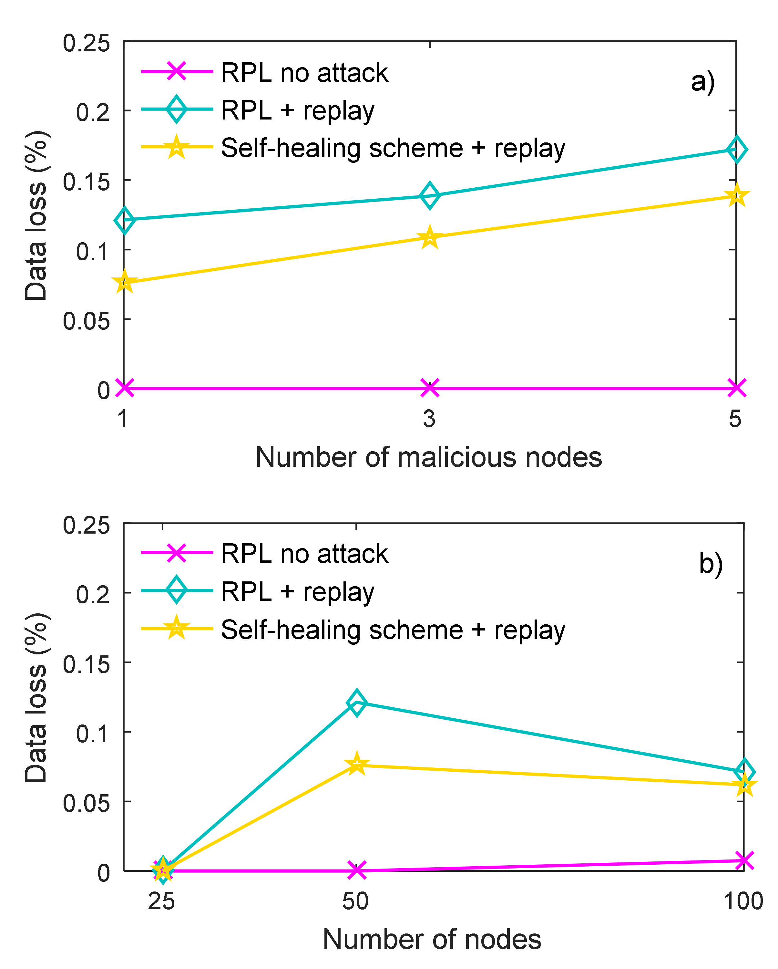
Our solution reduces data loss due to the varied attack scenarios down to 1% (5% on average)
Sinkhole attacks: a) 50 nodes, multiple attackers b) 25, 50 and 100 nodes, single attacker
Replay attacks: a) 50 nodes, multiple attackers b) 25, 50 and 100 nodes, single attacker
Blackhole attacks: a) 50 nodes, multiple attackers b) 25, 50 and 100 nodes, single attacker

Slide 12
It achieves low overheads of 1% and a detection reliability of 99.3% tested across scenarios
Overhead in 50 nodes network, multiple attackers a) sinkhole attack b) blackhole attack c) replay attack
The sensitivity of our solution can be adjusted per user requirements by setting a sensitivity parameter α. While α = 0.9 gives the lowest number of false positives, we opted for more conservative approach and α = 0.7 which ensures a good sensitivity to all attacks with 99.3% detection reliability.

Slide 13
To conclude…
Our experimental results showed high effectiveness in terms of data loss rate requiring low operational overheads for varied attack scenarios.
• CISCO/Silicon Valley Community Foundation “Fog to FIELD”
• S4 (EPSRC Programme Grant): Science for Sensor Systems Software
[1] I. Tomić and J. A. McCann. “A Survey of potential security issues in existing wireless sensor network protocols”, IEEE Internet of Things Journal, 2017.
[2] I. Tomić et al. “Run time self-healing security for wireless sensor networks”. July 2017. Under review.
[3] https://labs.ripe.net/Members/ivana_tomic/iot-turning-evil

Slide 14
Thank you for your attention!

